Slide 1

50.039 Theory and Practice of Deep Learning W3-S1 Introduction to Deep Learning using the PyTorch framework
Matthieu De Mari

Slide 2
Introduction (Week 3)
What is the PyTorch library and its benefits?
What is a PyTorch tensor object and its typical attributes?
How to implement some typical tensor operations?
What is broadcasting on tensors?
What are tensor locations in terms of computation?
How to transform our original NumPy shallow Neural Network class so it uses PyTorch now instead?
How to implement a forward, loss and accuracy metric in PyTorch?
What are some measurable performance benefits of using PyTorch over NumPy and GPUs over CPUs?

Slide 3
Introduction (Week 3)
What is the autograd/backprop module in PyTorch, and how does it use a computational graph to compute all derivatives?
How to use the autograd to implement derivatives and a vanilla gradient descent?
How to implement backprop in PyTorch for our shallow Neural Network class?
How to use PyTorch to implement advanced optimizers?
How to use PyTorch to implement advanced initializers?
How to use PyTorch to implement regularization?
How to finally revise our trainer function to obtain a minimal, yet complete Neural Network in PyTorch?

Slide 4
Introduction (Week 3)
What are the Dataset and Dataloader objects in PyTorch?
How to implement a custom Dataloader and Dataset object in PyTorch?
How to move from binary classification to multi-class classification?
How to adjust output probabilities using the softmax function?
How to change the cross-entropy loss so it works in multi-class classification?
How to implement building blocks in PyTorch?
How to implement and train our first Deep Neural Network?
What are additional good practices in PyTorch?

Slide 5

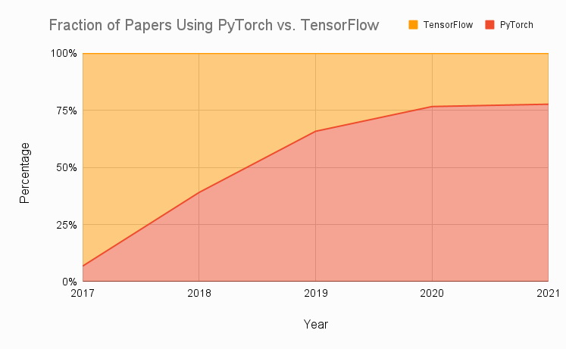
Technical pre-requisites
Framework of choice will be PyTorch! (not Tensorflow, not Keras, not MXNet, etc.)
Increasing popularity and preferred to Google’s Tensorflow these days for many reasons.
Learn more, if curious: https://www.assemblyai.com/blog/pytorch-vs-tensorflow-in-2022/

Slide 6
On the benefits of using PyTorch
There are several benefits to using PyTorch over NumPy for implementing neural networks:
More intuitive interface for working with tensors and neural networks.
NumPy is primarily a numerical computing library.
PyTorch is specifically designed with deep learning, and provides a more natural and convenient interface.
Large active community of users.
Many tutorials, detailed documentations and implementations on Github.
Stack overflow equivalent.

Slide 7
On the benefits of using PyTorch
There are several benefits to using PyTorch over NumPy for implementing neural networks:
PyTorch has better support for GPU acceleration than NumPy.
If a GPU is available, significantly speed up the training of our neural network by performing the computations on the GPU using PyTorch.
Especially useful for training large and complex models.
(More on this on Week 13!)
High-level abstractions for building and training neural networks.
Easier to write and debug code,
Improve the performance of our model by allowing PyTorch to apply optimization techniques
More specifically, automatic differentiation!

Slide 8
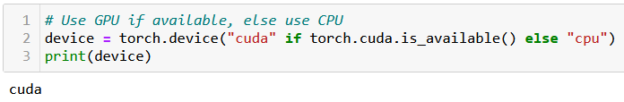
At this point, you should have installed PyTorch, and if possible, CUDA
You can check for CUDA/GPU capabilities, using the code below. If the CUDA has not been properly installed or the GPU is not compatible, you will be using a CPU instead.
We strongly advise to take a moment to make sure your machine is CUDA enabled, assuming your GPU is compatible (see W1S1 bonus).
When CUDA is properly installed on a compatible GPU, the line below should display cuda, otherwise it will print cpu.

Slide 9
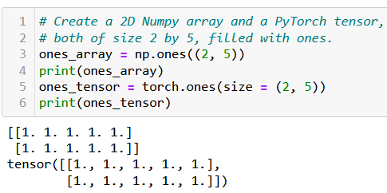
The Tensor object
Definition (Tensor):
The tensor is PyTorch's basic building block and is very similar to NumPy arrays.
This is why most of the concepts and methods will look similar
However, these come with additional features, which will be useful later on when building Neural Networks with these tensors.

Slide 10
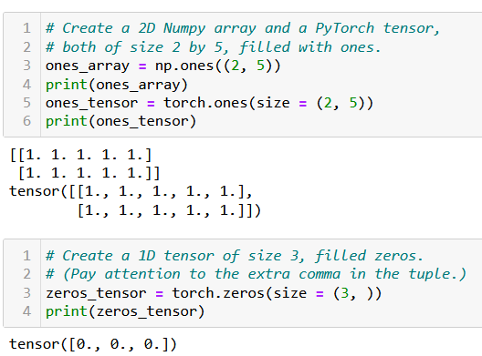
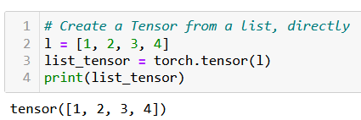
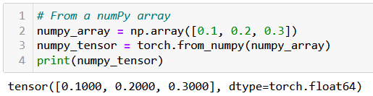
Creating a Tensor
Tensors can be simply created as in NumPy, by using zeros() or ones() functions, specifying dimensions of the expected Tensor, with tuples.
They can also be created from a list (of lists) of values, by passing it to the tensor() function.
Or from a Numpy array, using the from_numpy() method.

Slide 11
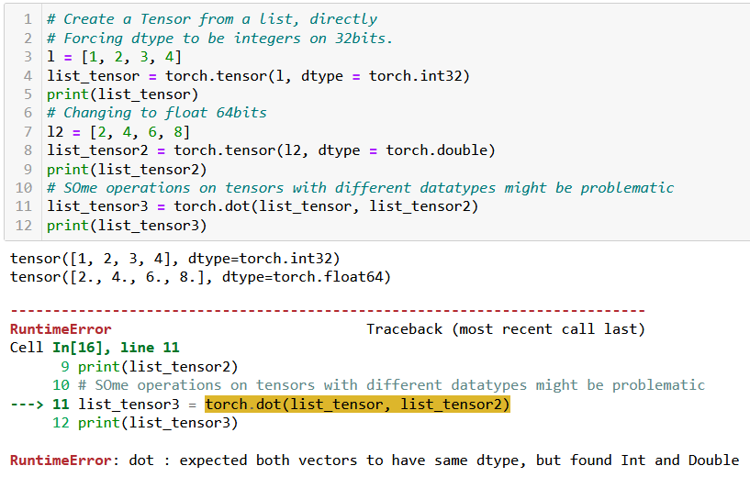
Tensor datatypes (dtypes)
Definition (dtypes):
PyTorch tensors have an attribute called dtype, which tracks the datatype of values stored in the tensor.
See link below for more details on the possible dtypes. https://www.tensorflow.org/api_docs/python/tf/dtypes
In general, operations between tensors require compatible, and sometimes identical dtypes.
Here, the dot product failed because one tensor was int, and the other was float/double.

Slide 12
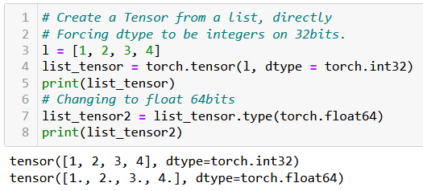
Tensor datatypes (dtypes)
Definition (dtypes):
PyTorch tensors have an attribute called dtype, which tracks the datatype of values stored in the tensor.
See link below for more details on the possible dtypes. https://www.tensorflow.org/api_docs/python/tf/dtypes
In general, operations between tensors require compatible, and sometimes identical dtypes.
You can change the dtype of a tensor
- by either specifying it explicitly during its creation;
- or by using the type() method on the tensor, casting a new dtype.

Slide 13
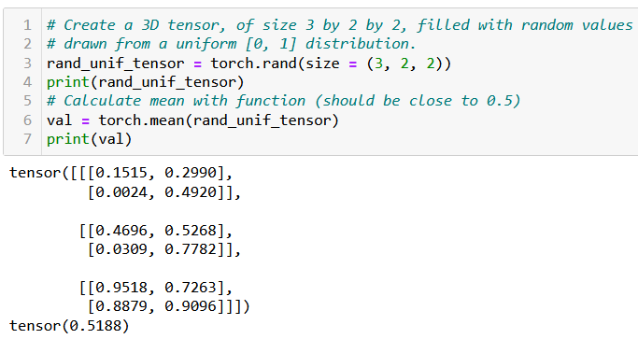
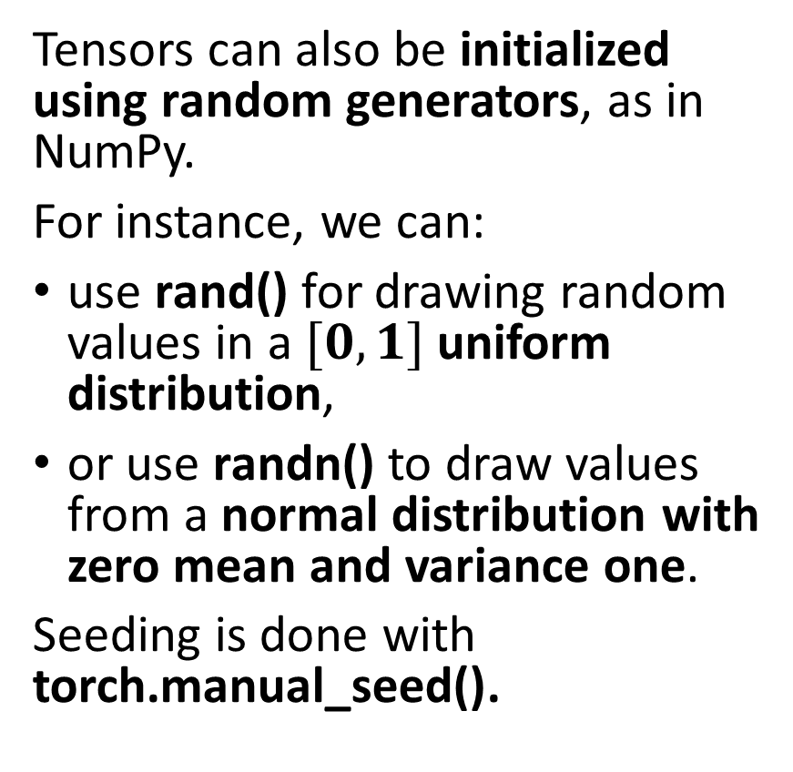
Tensor random initializers
Tensors can also be initialized using random generators, as in NumPy.
For instance, we can:
use rand() for drawing random values in a $[0, 1]$uniform distribution,
or use randn() to draw values from a normal distribution with zero mean and variance one.
Seeding is done with torch.manual_seed().
Functions and methods exist for calculating mean values of a tensor, its standard deviation/variance, etc.

Slide 14
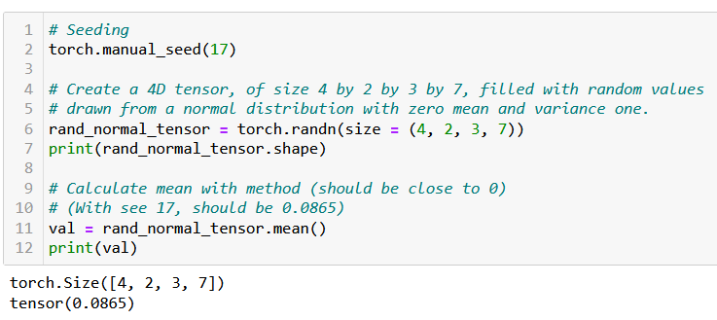
Tensor random initializers
Tensors can also be initialized using random generators, as in NumPy.
For instance, we can:
use rand() for drawing random values in a $[0, 1]$uniform distribution,
or use randn() to draw values from a normal distribution with zero mean and variance one.
Seeding is done with torch.manual_seed().
Functions and methods exist for calculating mean values of a tensor, its standard deviation/variance, etc.

Slide 15

Additional attributes of Tensors
Tensors come with many attributes and methods, e.g. asking the shape of a tensor, like in NumPy, is done using the shape attribute.
Not planning to cover all of these attributes and methods, because…

Slide 16
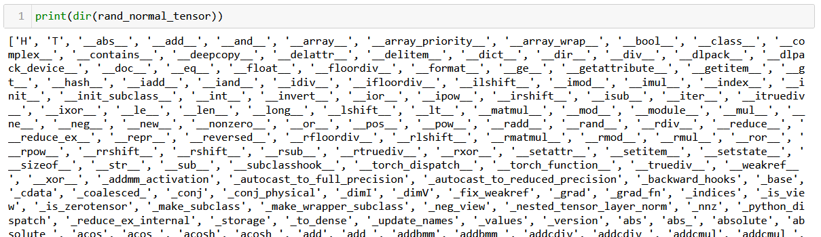
Additional attributes of Tensors
Tensors come with many attributes and methods, e.g. asking the shape of a tensor, like in NumPy, is done using the shape attribute.
Too many of them for me to cover, so RTFM!

Slide 17
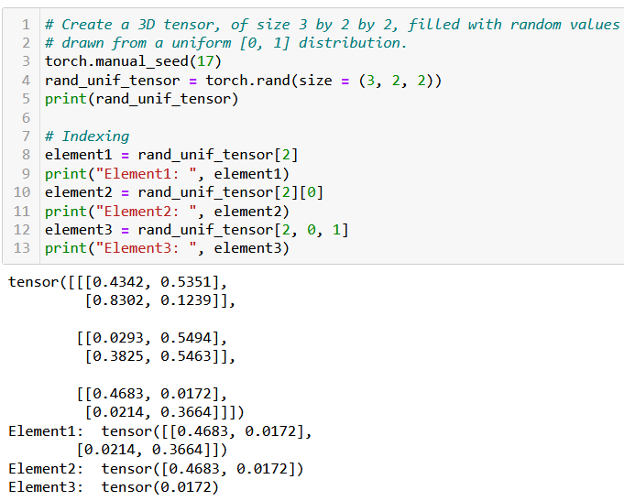
Basic operations on Tensors
All the typical element-wise operations on arrays work on tensors. For instance, we can:
access elements using the square bracket notation, multiple square bracket notations and multiple indexes in a single square bracket;
slice a tensor using the square bracket notation and colon symbol;
update elements of a tensor using the square bracket notation;
browse through elements of a tensor using a for loop.

Slide 18
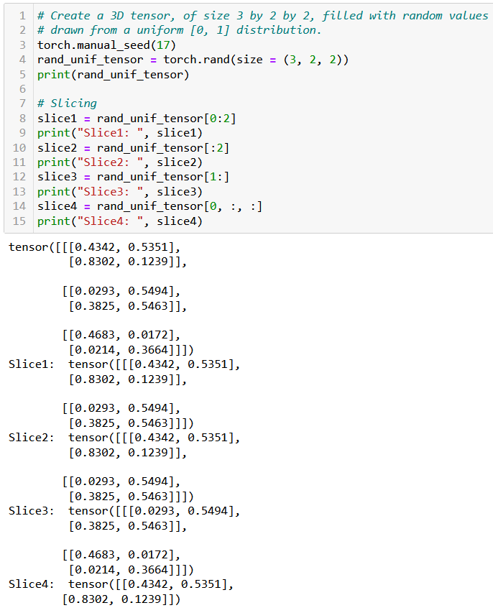
Basic operations on Tensors
All the typical element-wise operations on arrays work on tensors. For instance, we can:
access elements using the square bracket notation, multiple square bracket notations and multiple indexes in a single square bracket;
slice a tensor using the square bracket notation and colon symbol;
update elements of a tensor using the square bracket notation;
browse through elements of a tensor using a for loop.

Slide 19
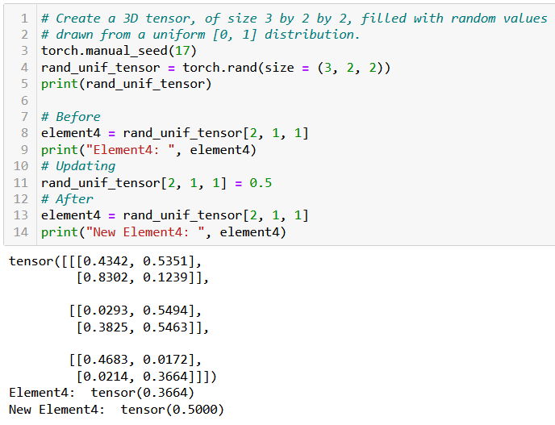
Basic operations on Tensors
All the typical element-wise operations on arrays work on tensors. For instance, we can:
access elements using the square bracket notation, multiple square bracket notations and multiple indexes in a single square bracket;
slice a tensor using the square bracket notation and colon symbol;
update elements of a tensor using the square bracket notation;
browse through elements of a tensor using a for loop.

Slide 20
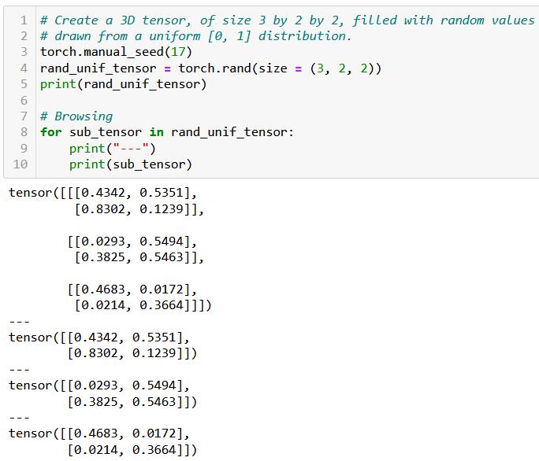
Basic operations on Tensors
All the typical element-wise operations on arrays work on tensors. For instance, we can:
access elements using the square bracket notation, multiple square bracket notations and multiple indexes in a single square bracket;
slice a tensor using the square bracket notation and colon symbol;
update elements of a tensor using the square bracket notation;
browse through elements of a tensor using a for loop.

Slide 21

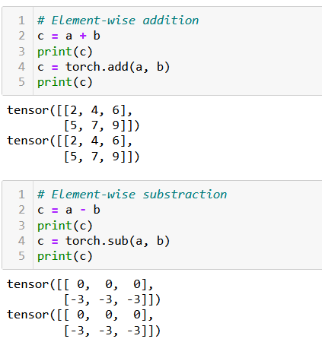
Arithmetic operations on Tensors
All NumPy array operations work on Tensors and equivalent methods have been written in torch as well.
Element-wise Addition/Subtraction,

Slide 22
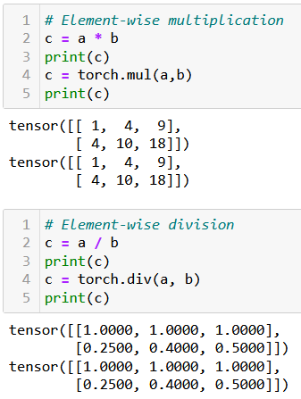
Arithmetic operations on Tensors
All NumPy array operations work on Tensors and equivalent methods have been written in torch as well.
Element-wise Addition/Subtraction,
Element-wise Multiplication/Division,

Slide 23
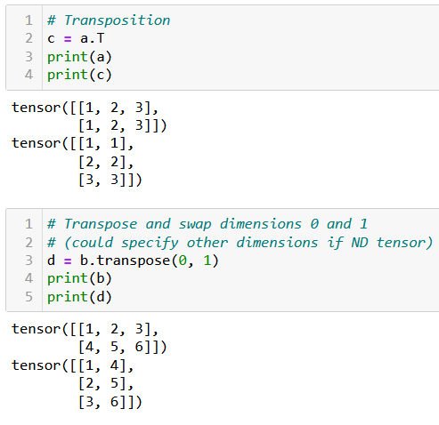
Arithmetic operations on Tensors
All NumPy array operations work on Tensors and equivalent methods have been written in torch as well.
Element-wise Addition/Subtraction,
Element-wise Multiplication/Division,
Transposition,

Slide 24
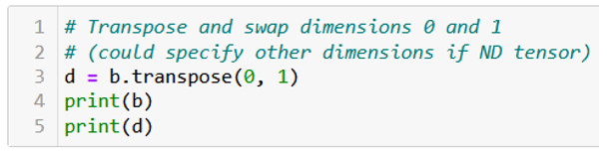
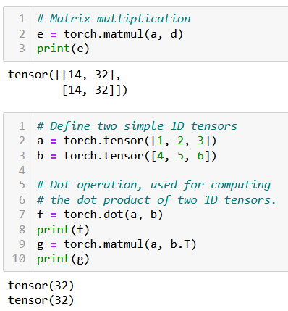
Arithmetic operations on Tensors
All NumPy array operations work on Tensors and equivalent methods have been written in torch as well.
Element-wise Addition/Subtraction,
Element-wise Multiplication/Division,
Transposition,
Matrix multiplication and dot product,
Along with more Linear Algebra stuff (now is the time to revise!).

Slide 25
A quick note on broadcasting
Tensors, just like NumPy arrays, support broadcasting.
Two tensors are “broadcastable” if the following rules hold:
Each tensor has at least one dimension.
When iterating over the dimension sizes, starting at the trailing dimension, the dimension sizes must either be equal, one of them is 1, or one of them does not exist.
If two tensors x, y are “broadcastable”, the resulting tensor size is calculated as follows:
If the number of dimensions of x and y are not equal, prepend 1 to the dimensions of the tensor with fewer dimensions to make them equal length.
Then, for each dimension size, the resulting dimension size is the max of the sizes of x and y along that dimension.

Slide 26
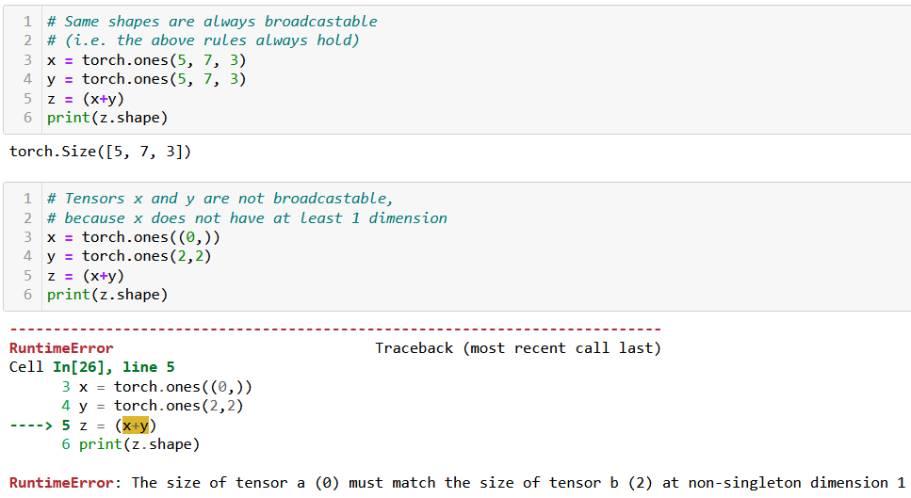
A quick note on broadcasting

Slide 27
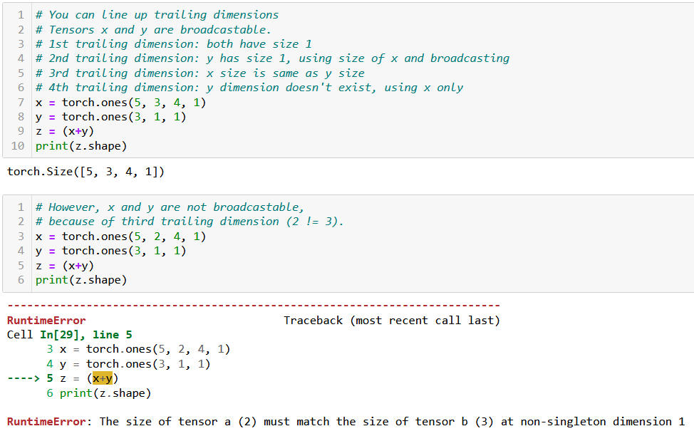
A quick note on broadcasting

Slide 28

Tensor locations
Recall: PyTorch has better support for GPU acceleration than NumPy.
If a GPU is available, significantly speed up the training of our neural network by performing the computations on the GPU using PyTorch.
Especially useful for training large and complex models.

Slide 29
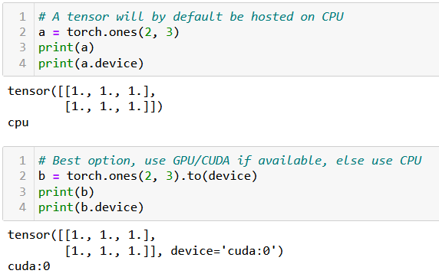
Tensor locations
By default, all tensors are used by the CPU. If device enabled for GPU/CUDA computation, transfer the tensor to the GPU for faster computation.
This is done in three ways:
Using .to(device) method will transfer to the best device available for computation (device variable was defined earlier, when we checked for cuda/cpu).
Using .cpu() or .cuda() will force transfer to the cpu or cuda respectively. Note that it might fail if you machine is not CUDA compatible.

Slide 30
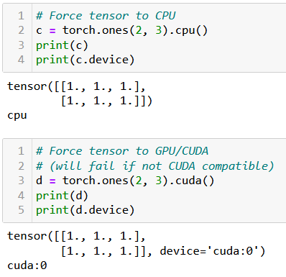
Tensor locations
By default, all tensors are used by the CPU. If device enabled for GPU/CUDA computation, transfer the tensor to the GPU for faster computation.
This is done in three ways:
Using .to(device) method will transfer to the best device available for computation (device variable was defined earlier, when we checked for cuda/cpu).
Using .cpu() or .cuda() will force transfer to the CPU or CUDA respectively. Note that it might fail if your machine is not CUDA compatible.

Slide 31
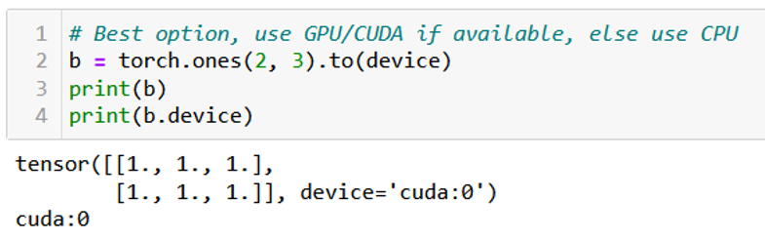
Tensor locations
By default, all tensors are used by the CPU. If device enabled for GPU/CUDA computation, transfer the tensor to the GPU for faster computation.
This is done in three ways:
Using .to(device) method will transfer to the best device available for computation (device variable was defined earlier, when we checked for cuda/cpu).
Using .cpu() or .cuda() will force transfer to the CPU or CUDA respectively. Note that it might fail if your machine is not CUDA compatible.
In doubt, you can check the device attribute of your tensors to find where their computations will occur.

Slide 32
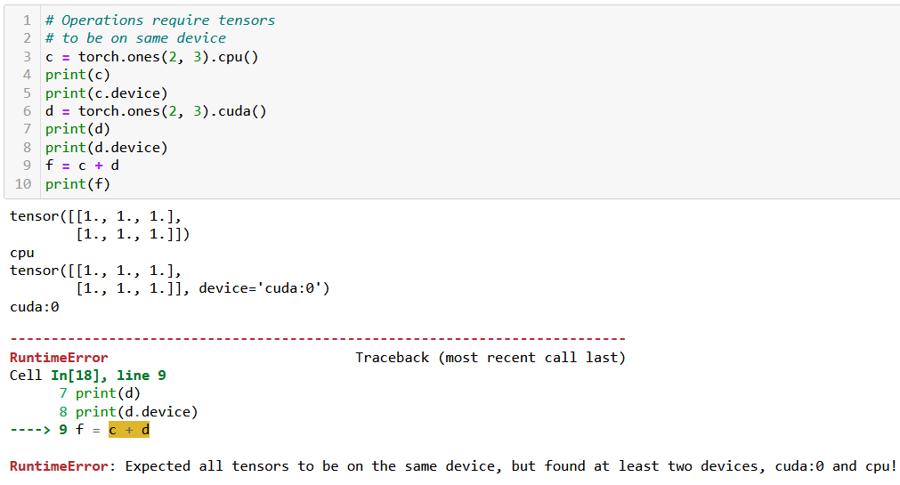
Tensor locations
Very important: two tensors with different devices cannot be used in the same operation! (same logic as with the dtypes).

Slide 33
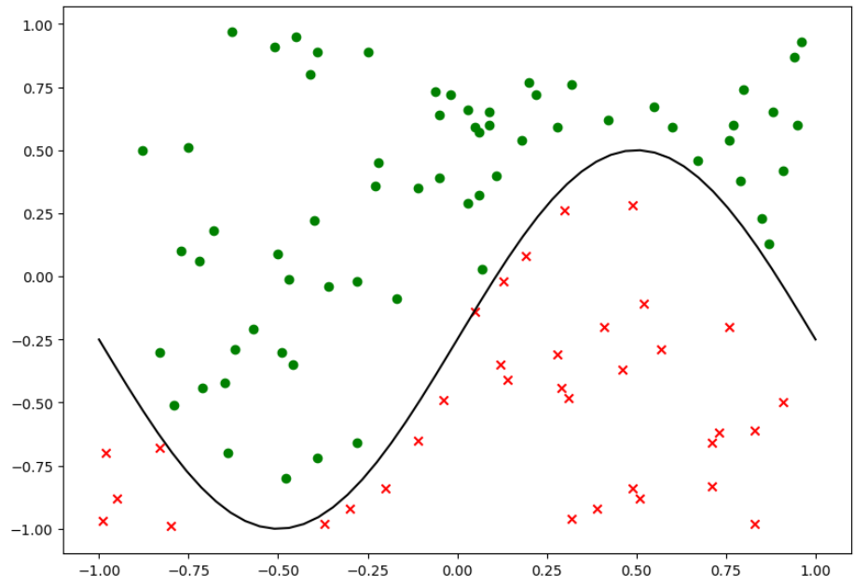
Same dataset as before

Slide 34
Our shallow neural network class
We will reuse our previous ShallowNeuralNet class from Week2 Notebook 7, which:
implements a Shallow neural network using two fully connected layers and sigmoid activation functions,
uses a Stochastic Mini-Batch gradient descent, with Adam as its optimizer,
uses a random normal initialization,
comes with a forward() method for predictions,
comes with a backward() and train() method for backpropagation training,
comes with a cross-entropy loss function and an accuracy metric function,
comes with a display function, to show training curves on both the loss and the accuracy,
comes with save and load functions.
Let us start by replicating the init, forward, loss and accuracy methods in PyTorch.

Slide 35
Writing a PyTorch neural network
The main differences between the original class and the PyTorch version are:
The PyTorch version of the class should inherit from torch.nn.Module and call its parent's init method using super().
This is necessary because PyTorch uses classes inherited from torch.nn.Module to keep track of the layers and their parameters in a neural network.
Instead of using NumPy arrays for the weights and biases, the PyTorch version uses torch.nn.Parameter objects, which is a subclass of tensors, whose values can be trained and modified later.

Slide 36
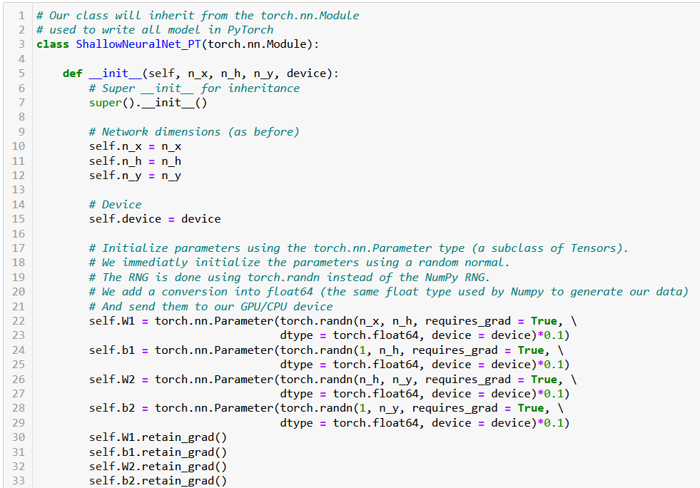

Slide 37
Writing a PyTorch neural network
In PyTorch, requires_grad is an attribute of tensors that allows the gradients to be accumulated for a particular tensor, during forward operations and backpropagation.
Setting retain_grad() to True for a tensor will tell PyTorch to keep track of operations happening during the forward pass, later allowing to compute the gradients of these intermediate tensors.
This will eventually serve to perform parameters updates via backpropagation.
To keep it simple: Trainable parameters should allow for gradients to be retained for backpropagation.

Slide 38
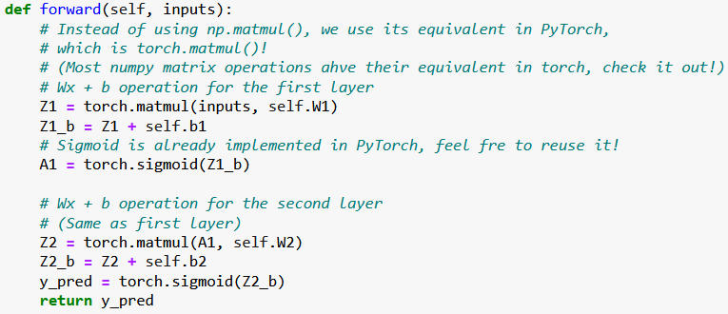
Rewriting the forward pass
The forward pass can be rewritten. You can replace most NumPy operations with their PyTorch equivalents. Similarly, our activation function sigmoid is replaced with PyTorch's torch.sigmoid() function.

Slide 39
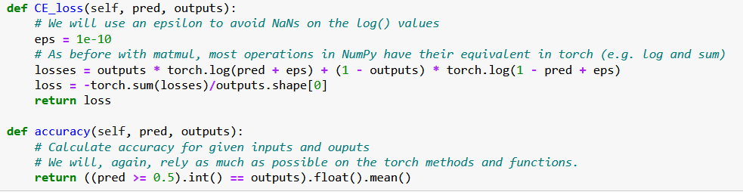
Rewriting the loss and accuracy functions
Similarly, we can rewrite the loss and accuracy functions using torch functions in place of the Numpy ones, also vectorizing operations as much as possible.

Slide 40
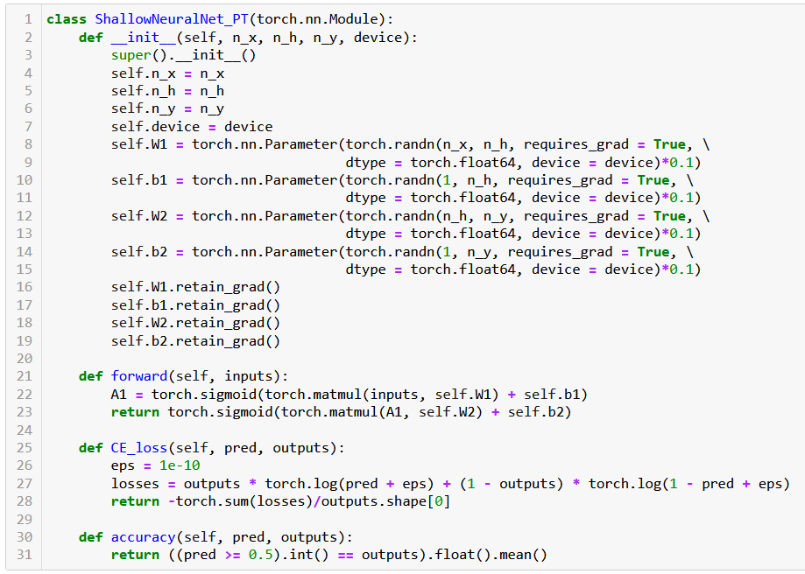

Slide 41
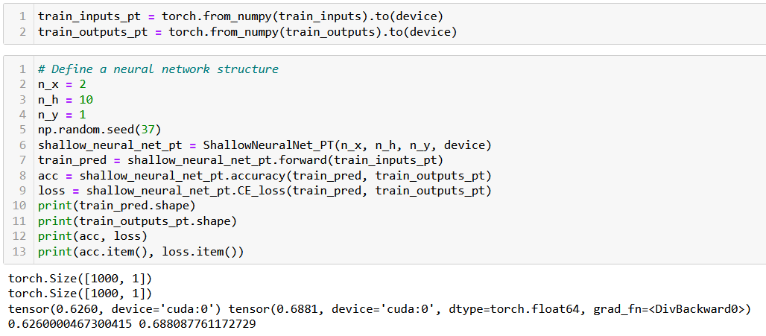
Trying out our new neural network
Before using this Neural Network on our dataset, we need to convert our samples to PyTorch Tensor objects and send them to GPU (if available).

Slide 42
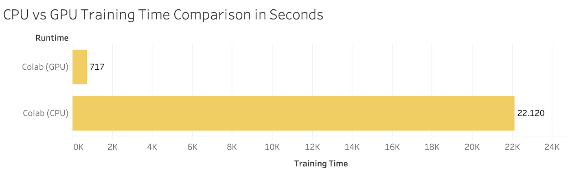
Computation times comparison
Let us run both models (the NumPy one and the PyTorch one) and ask them to perform 1000 times the accuracy computation.
On my machine (CUDA, Nvidia GTX 4070), the PyTorch model is roughly 30 times faster!
(Obviously depends on your machine, could be even more on some specific DL GPUs).

Slide 43
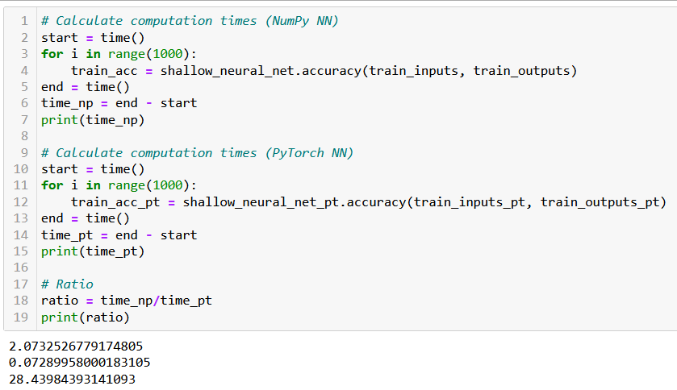
Computation times comparison

Slide 44
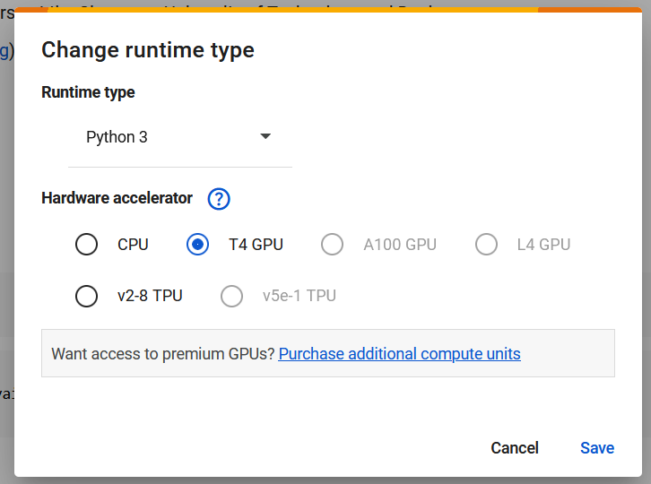
A note for those of you running on MacOS
Use Google Colab, but remember to select GPUs are runtime hardware (by default CPU).
Also the option of using MPS (but you have to figure it out!)
Careful, as of Feb 2025, float64 is not a valid datatype in MPS, might need to use float32 in notebooks instead.
Possibly more adjustments needed…

Slide 45
A bit of practice for you
In order to practice your PyTorch Tensor skills,
Have a look at Notebook #3,
It contains three functions (computing the mean of a 2D tensor column-wise, finding indices where the values a 2D tensor are greater than 5, concatenating two 2D tensors, etc.)
Solutions are given in the Notebook 3 solution folder.
Let us use the remaining time to practice.

Slide 46
A bit of practice for you
In order to continue your practice your PyTorch Tensor skills, you may try to manually implement some typical algorithms using the basic operations on PyTorch tensors:
Finding the maximum, minimum, average, median values of a given 1D tensor,
Transposing a given 2D tensor, computing its determinant, eigenvalues/eigenvectors,
Sorting a given 1D tensor (bubble sort, insertion sort, selection sort, quick sort, merge sort),
Generating a 1D array containing the first K Fibonacci numbers with K given,
Etc.
Later, you can check their performance times compared to their Numpy/PyTorch implementations when running them on CPU and CUDA. In which scenarios is it slower to implement said functions and run them on GPU?

